Slide 1
Survey analysis week 38 Decomposing error and bias “Total Survey Error”
© Peter Lugtig
p.lugtig@uu.nl

Slide 2
Class exercise week 1 (at home)
https://utrecht-university.shinyapps.io/SDA_shinyelectionbias/
Was Trump underestimated?
… in the swing states? (Michigan, Wisconsin, Pensylvania)
Did the quality of the pollster matter?
Was there a difference between sampling likely voters and registered voters?
Are larger polls better?
Is there a difference between raw and modeled polls?

Slide 3
Today
Bias, error and MSE
Total Survey Error (TSE)
Total data error (TDE)
How survey design affects error
The central role of survey modes

Slide 4
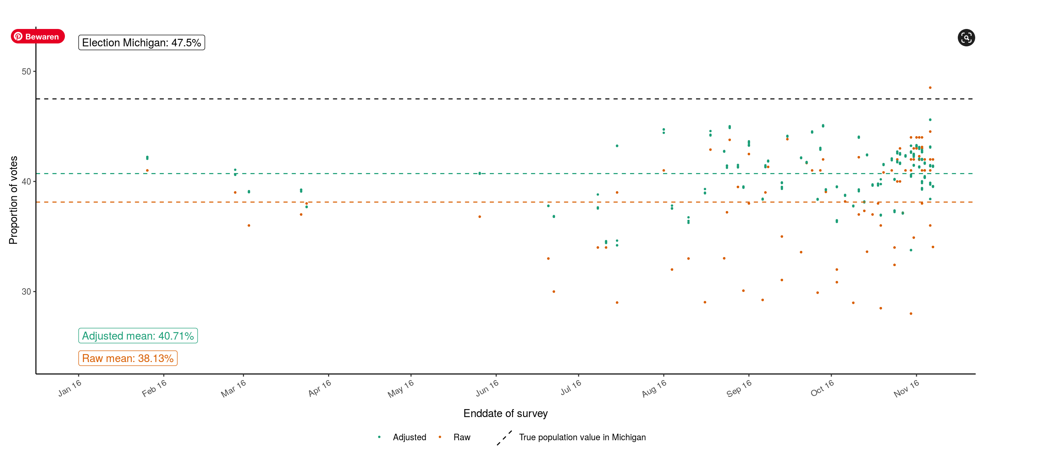
Class exercise week 1

Slide 5
Class exercise week 1
Let’s focus on 1 sample:
Why could it be off?

Slide 6
1 sample in Michigan: point estimate
Estimate: 48%
n= 1000
30%
70%

Slide 7
1 sample: bias
Estimate: 48%
True value: 47.5%
Bias: 48-47.5 = 0.5% (biemer, 2010)
30%
70%

Slide 8
1 sample: error
Point estimate: 48%
Standard error (Se)r =
Se(r): sqrt(.48*.52)/ 1000 = .016
Confidence interval: [.45 - .51]
[p +- 1.96 * se]
Is error or bias a bigger problem?
30%
70%

Slide 9
Estimate + error + bias
True value is within confidence interval!
So, we have to assume there is bias
Or, is the bias we see higher than expected error?
Next week, more on bias and error in samples
Mean Squared error (MSE): bias² + error
30%
70%

Slide 10
Mean square error
MSE = .005² + .016 = .000025 + .016 = .016025
Sampling error seems larger problem
Biemer: a bit more complicated as true value also has a variance
Estimating population variance in mean tricky…
30%
70%

Slide 11
Survey design
What if we increase sample size?
10000 instead of 1000?
Se(r): sqrt(.48*.52)/ 10000 = .005

Slide 12
Why we still worry about bias

Slide 13
Bias and error in more detail
Total Survey Error

Slide 14
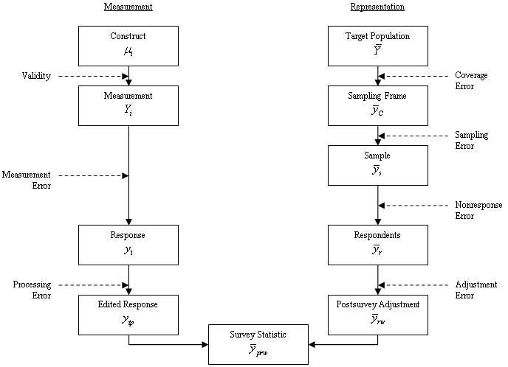
Total Survey Error Framework
(Groves et al. 2009, p.48)

Slide 15
Total Survey Error (TSE) Framework
Coverage Error
Discrepancy between target population and available sampling frames
(Groves et al. 2009, p.48)
Notes:
Die Fehler erst nach und nach einblenden!!!!

Slide 16
Terminology: coverage error
(target) Population: group of units (people, companies, households, etc.) you are studying
Sampling frame: list containing population elements
Undercoverage: should be on, but is not
Not have an address, telephone, e-mail
Overcoverage: should not be on, but is
Two phones, multiple e-mail, has died, has moved
From: population register, schools, health records

Slide 17

Coverage error and modes
Modes:
Web: no lists of e-mailadresses (unless special population)
Paper: invitations by mail to households
face-to-face: Use list addresses or random walk
Telephone: Random Digit Dialing, mobile phones
Lists are seldom up-to-date
Really….

Slide 18
TSE – sampling error
Sampling Error
Originates from not observing all units in a sampling frame, but just a random sub-sample. This is why we calculate standard errors, confidence intervals etc.
Notes:
No within-household selection procedures were used in telephone surveys
Some used dual frame but not all
Although write that they used RDD, they in fact used non-random probability methods with an element of random selection of numbers (talk about Haeder-Gabler method and last birthday)

Slide 19
Terminology: sampling error
Sampling unit: collection of units to be sampled from your frame
Sample: the actual units you sample
Respondents: the people out of the sample who participate
Sampling can introduce bias and error!
Selecting people within households
Villages, hospitals, etc, etc.

Slide 20
TSE – nonresponse error
Nonresponse Error
The discrepancy between the gross sample and the net sample of observed unit.
(Groves et al. 2009, p.48)
Notes:
The report did not focus on nonresponse in detail unfortunately
Talk about e.g., topic influence (political interest), not possible to actually calculate response rates in online surveys, „early“/“easy“ respondents in online panels and telephone surveys when working with quotas, etc.

Slide 21
Nonresponse error and bias
Source: Groves, R. M., & Peytcheva, E. (2008). The impact of nonresponse rates on nonresponse bias: a meta-analysis. Public opinion quarterly, 72(2), 167-189.

Slide 22
Total Survey Error (TSE) Framework
Adjustment Error
By means of post-survey adjustments (e.g. weighting and imputations) we aim to correct for coverage, sampling and nonresponse errors.
(Groves et al. 2009, p.48)

Slide 23
TSE – construct validity
Construct Validity
The discrepancy between construct and measurement instrument.
(Groves et al. 2009, p.48)

Slide 24
TSE – measurement error
Measurement Error
The discrepancy between ideal measurement and actual answers given, e.g. because of:
Misunderstandings
Social desirability bias
Satisficing
(Groves et al. 2009, p.48)

Slide 25
TSE – processing error
Processing Error
The discrepancy between the variable used in the estimation and respondents’ actual answers, e.g. because of post-survey coding and editing.
(Groves et al. 2009, p.48)

Slide 26
In sum
In design-based surveys:
Sampling error only error we know
We can control by increasing sample size
But many more sources of error/bias
Hard to always quantify exactly
It is not strange polls are off!
Key question in Survey design:
In order to minimize MSE:
Do we invest in larger sample, or more nonresponse follow-ups? Incentives, etc?

Slide 27
Exercise 1a (and then break)
Form pairs and tell (and ask!):
What is the name of your survey?
What is the population of the study?
How are individuals selected to be invited for the survey? (sampling design)
What is the sample size?
What survey mode is being used?
What methods to prevent nonresponse?
What are the central concepts that are measured in the survey?

Slide 28
TSE and survey design
Design aspects greatly affect survey errors
Invitation mode
Administration mode
Interviewers
Incentives
Questionnaire length
Etc.

Slide 29
Groves and Lyberg (2010)
History of the TSE framework
There are extensions to
comparative surveys (Smith 2010),
longitudinal surveys (Lynn and Lugtig 2017),
analytic error (West and Saskhaug 2018)
… and Total Data error (other data sources)
Administrative, sensor, social media, etc.
See also weeks 49,50

Slide 30
TSE and model-based inference
Convenience samples
Volunteer opt-in panels
(Quota samples)
Lab-studies (psychology), organic data, social media, etc.

Slide 31
Model-based inference
Compare data to population, model
selection bias
(Groves et al. 2009, p.48)

Slide 32
Exercise 1b (and then break)
Form pairs and discuss
What do you think is the biggest source of error in your chosen survey?
choose 1!

Slide 33
Exercise 1b
Noncoverage error
Sampling error
Nonresponse error
Adjustment error
Validity
Measurement error
Processing error

Slide 34
In sum: How much to worry about each?
 | Bias | Error
Coverage error | **
Sampling error | * | ***
Nonresponse error | *** | *
Adjustment error |  | *
Validity of measurement | ***
Measurement error | ** | **
Processing error |  | *

Slide 35
In sum: How much to worry about each?
 | Bias | Error
Coverage error | **
Sampling error | * | ***
Nonresponse error | *** | *
Adjustment error |  | *
Validity of measurement | ***
Measurement error | ** | **
Processing error |  | *

Slide 36
Exercise: survey design
Survey design. Think about:
1. the list you could use (coverage error)
2. the mode of the invitation
3. The mode of survey administration
4. Nonresponse error
(i.e. do not think about sample size)
15 minutes and report back

Slide 37
Class Exercise 2: group 1
A researcher would like to know to what extent neighbours in high-rise flats (over 8 floors tall) in Utrecht help eachother out. She suspects that people help eachother mainly if they have the same ethnic and socio-economic background.

Slide 38
Class Exercise 2: group 2
A researcher would like to study employee satisfaction in the Netherlands. The researcher is interested to study satisfaction in companies of different sizes (small/medium/large), and in different types of trade (services/government/industry/agriculture). The budget for the study is limited, so that the researcher can only include about 100 companies in the study.

Slide 39
Class Exercise 2: group 3
A researcher would like to do a survey among homosexual muslims in the region of Utrecht to find out how the families of these men and women deal with this.

Slide 40
Class Exercise 2: group 4
For the next elections for the European parliament, a market research firm with offices in all EU countries would like to do a pan-EU survey among the EU electorate to
a) predict the outcome of the election in every country and
b) compare the attitudes of people in different countries towards the European Parliament.

Slide 41
Class Exercise 2: group 5
A researcher would like to do a survey among elderly people (age 70+) who group in shopping centres (malls) in the USA during the day. She is interested to find out why those elderly people choose to convene in malls, and not in any different place.

Slide 42
Class Exercise 2: group 6
A researcher would like to better understand how patients who developed Covid-19 in the spring of 2020 (March-april) in Italy are now recovering from their illness. There is no central registry of patients in Italy; these are kept at hospitals, and if you want to reach these patients it is necessary to collaborate with individual hospitals in Italy.
In the survey you want to ask questions about phsyical and mental wellbeing, as well as the effects Covid-19 has had on relations with household members (children, partner).

Slide 43
Next week
Prepare
1. Read Stuart (see e-mail last week)
Simple Random sampling
2. Do THE exercise 2 (sampling)
Lecture on Simple Random Samples

